Slide 1

Presented By: Chaitali Vinayak Deore Batch Code: fst 2.0 ML9 class: TYBsc-cs Mentor: Ashwini Kakde Mam

Slide 2
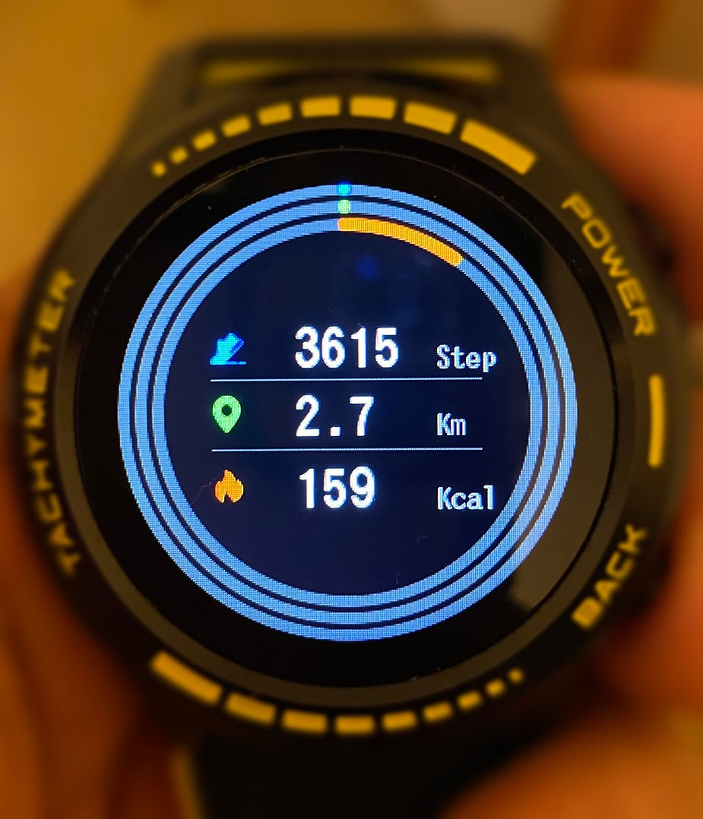
Project Name:
Calories Burnt Prediction

Slide 3
Contents:
Introduction:
Libraries:
Algorithm:
CSV file:
Advantages:
Reference:
Conclusion:

Slide 4
Introduction
The body temperature and the heartbeat will rise when we exercise or workout. The variables that we take here such as time scale for which the individual carrying out the workout training and what is the average beats per minute and then the temperature. Then we additionally take the height, weight, gender and age of the person to predict how tons energy the person may be burning. A machine learning linear regression algorithm, Decision tree regressor, Random forest regressor are used to predict calories burned depends on the workout duration, body temperature, height, weight and age of the person.

Slide 5
Libraries used in project
pandas: for data analysis.
numpy: for numeric calculation.
matplotlib: for data visualization.
seaborn: for making statistical graphics.
From sklearn.model import train_test_split: The train-test split is used to estimate the performance of machine learning algorithms that are applicable for prediction-based Algorithms/Applications.

Slide 6
Algorithm used in Project
Linear regression: Linear Regression in Machine Learning analysis is important for evaluating data and establishing a definite relationship between two or more variables.
Random forest regression: Random forest is a ensemble learning method, which means it uses a combination of multiple models to make predictions.

Slide 7
SVR: Support Vector Regression is a supervised learning algorithm that is used to predict discrete values.The basic idea behind SVR is to find the best fit line. In SVR, the best fit line is the hyperplane that has the maximum number of points.

Slide 8
Csv file used in Project:
CSV files :
Calories: Calories csv file has Person User_ID and Calories.
Exercise: exercise csv file has person gender, age, height, weight, duration, heart_rate, body_temp.

Slide 9
Advantages:
Boost cardiovascular health: Control your blood sugar levels and improve your heart health.
Manage your weight: Burning 300 calories daily can help you lose half kg of weight every 2 weeks.
Enhanced physical strength: Burning off 300 calories every day will reduce the amount of body fat in your body and increase muscle mass.

Slide 10
Reference:
DataSet From Kaggle.com:
https://www.kaggle.com/code/muskanjha/calories-burnt-prediction

Slide 11
Conclusion:
According to person’s height, weight, gender and age to predict how much energy that person is burning.
By testing with different ML prediction models such as linear regression,SVR, Random forest regression it has been established that out with Random forest regression better accuracy in predicting.

Slide 12


